Slide 1
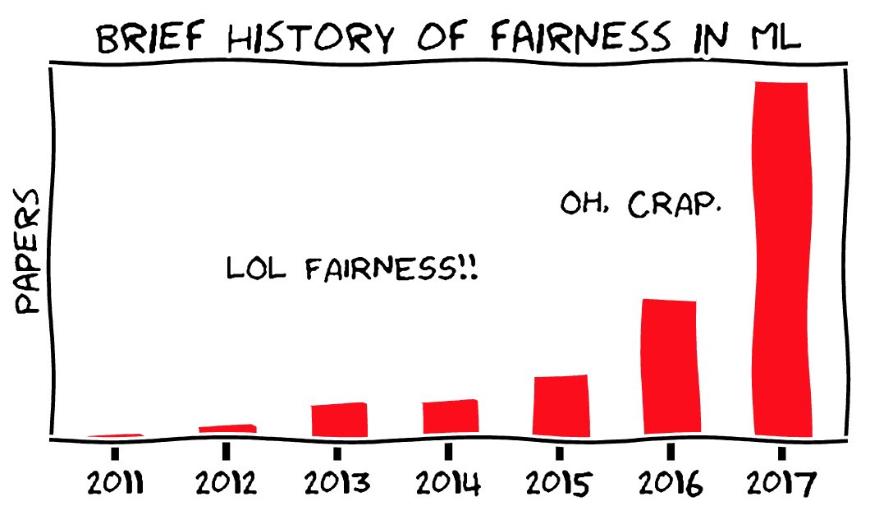
Section 4
Bias, Fairness, and Tradeoffs

Slide 2
Why is this important?
ML models deployed into the world have large impacts on people’s lives
Getting approved for a loan
Self-driving cars
Facial recognition for surveillance
Job applicant selection
Models can lead to negative outcomes for a person due to inherent factors outside their control (unfairness)
You wouldn’t want this to happen to you! So we should work to make sure models are fair for everyone

Slide 3
Biases
Huge contributor to unfairness in ML!
Biases arise as an unintended property of our data, model, deployment method, etc.
Six main forms of bias we’ll talk about in this class...

Slide 4
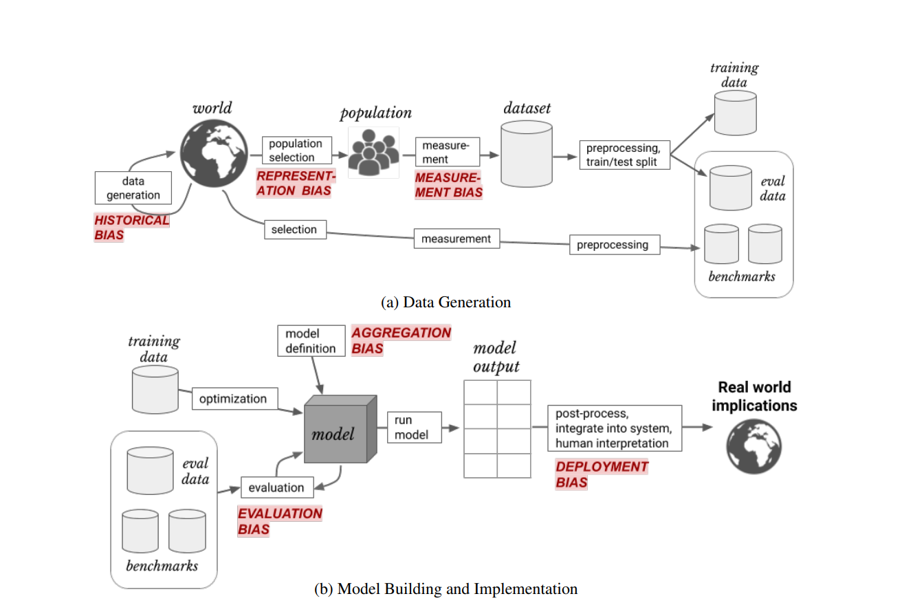

Slide 5
Biases (cont.)
Historical Bias
Misalignment between the world and the values/objectives we want to propagate
Underlying factors from reality that affect our data
Even perfect data measurement and sampling would not prevent this bias
Example: Historically, most US politicians have been white males. Using political speech data for NLP may inherently reflect non-diverse viewpoints.
Measurement Bias
Our measurements are often proxies for the true value we care about
This proxy may not be equal across groups
Example: Using GPA to measure how hard a student worked (doesn’t factor in extra curriculars, life circumstances, etc.)

Slide 6
Biases (cont.)
Representation Bias
The distribution of samples in our data does not reflect the true distribution
Underrepresentation of certain groups
Example: Predicting what someone’s face looks like using an image of the back of their head (call it... FaceBack) will not work well for everyone if you just train on images of NYC detectives.
Aggregation Bias
Using a single model to describe a collection of groups that may vary
Not “one size fits all” in reality
Example: A single model that aims to predict a person’s pants size based on their height, without accounting for sex.

Slide 7
Biases (cont.)
Evaluation Bias
Validation or benchmark data doesn’t reflect the target population
Like representation bias but not for training data
Example: Using a benchmark dataset consisting of images of Welsh Corgis to evaluate your dog breed predicting model.
Deployment
A model is used post-deployment in an unintended way
The problem it was meant to solve doesn’t match the problem it is being used to solve
Example: A model meant to predict cancer risk from DNA sequence is used to deny certain people insurance coverage.

Slide 8
Discussion question #1
You are training a model to predict a student’s GPA based on how hard they work. You use exercise regiment (how often do they work out, how much can they bench, etc.) to represent hardworkingness. Also, you don’t want to conduct an extensive survey so you decide to only poll your fellow classmates in CSE 416! Which of these biases might this situation lead to?
Historical
Representation
Measurement
Aggregation
Evaluation
Deployment

Slide 9
Discussion question #2
You develop an app to help those most at-risk of falling victim to nicotine addiction. Because you believe in free and open source software, you upload all your code to GitHub. Unfortunately, this allows a large cigarette company to use your model to target ads to groups of people who are most susceptible to nicotine addiction and thus more likely to buy cigarettes. Which of these biases might this situation lead to?
Historical
Representation
Measurement
Aggregation
Evaluation
Deployment

Slide 10
Types of fairness
There are many different methods of measuring fairness
These methods can be contradictory!
We will focus on group fairness specifically but there are other types of fairness you may care about based on your personal philosophy
Types of fairness we care about also depends on the application!

Slide 11
Types of fairness (cont.)
Fairness through unawareness / group “blind”
Just don’t look at which samples are in which protected group!
Doesn’t really work as it falls prey to historical and measurement bias since many features can be influenced by group.
Statistical parity
Outcomes are representative of true group distributions
The proportion of those labeled “+” in group A is equal to those labeled “+” in group B
Leads to selection issues (ex. Strict selection criteria for one group but not the other)

Slide 12
Types of fairness (cont.)
Equal Opportunity
False negative rates (or true positive) should be equal across groups.
The proportion of those falsely labeled “-” in group A should match that of group “B”
Example: The rate of women getting rejected for a job despite being qualified should match the rate of men.
Predictive Equality
False positive rates (or true negative) should be equal across groups.
The proportion of those falsely labeled “+” in group A should match that of group “B”
Example: The rate of young people getting accepted for a loan despite not being able to pay it should match the rate of the elderly.

Slide 13
Discussion question #3
You work at a health insurance company and have constructed a model that decides who gets coverage for insulin and who does not (you want to avoid covering those with pre-existing conditions requiring insulin). Which type of fairness might you want to achieve?
Group Blind
Statistical Parity
Equal Opportunity
Predictive Equality

Slide 14
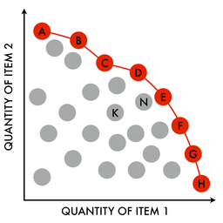
Trade-offs
There is an inherent tradeoff between model accuracy and model fairness.
If our optimal model is unfair, any changes to increase fairness will make it sub-optimal for accuracy.
The “Pareto Frontier” describes a group of models where we cannot increase fairness without sacrificing accuracy and vice-versa. No modification can be made to increase both.
We have to make the tough decisions to figure out how to prioritize accuracy and fairness.
Another reason fairness in ML is important: accuracy often equals money in the corporate world. Companies may want to maximize accuracy only to meet their bottom line. We now know that this inherently minimizes fairness!

Slide 15
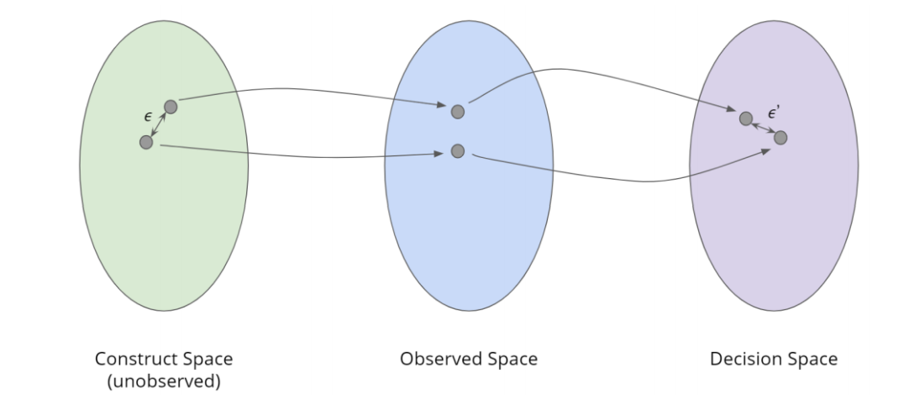
Spaces
ML described through a constructed, observed, and decision space.
The constructed space is unobserved and contains true values we cannot know but are trying to estimate.
The observed space is where we make our approximations and measurements.
The decision space is where our model uses the observations to make decisions.

Slide 16

Worldviews
Different worldviews confer different fairness strategies
Individual fairness is the idea that those who are close in construct space must be similar in the decision space.
“What you see is what you get” is the idea that the observed space represents the construct space faithfully. Individual fairness is guaranteed here.
Structural bias and “we are all equal” means that the observed space is different than the construct space (due to structural bias). We also assume that membership in a group is not the sole cause of our observed difference.

Slide 17
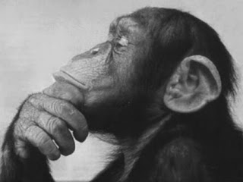
Discussion questions #4 and #5
In which situations would the “what you see is what you get” worldview be particularly appropriate or inappropriate? What about structural bias + WAE? Do you believe we can switch between worldviews depending on the application or must we stick to one?
How does your own personal philosophy affect your view on bias and fairness in ML?

